Slide 1
Azure Document Intelligence
Zero to Hero Workshop

Slide 2
Prerequisites
Azure Subscription
Azure Resource Group
Azure Document Intelligence
Azure Computer Vision
Azure Storage Account

Slide 3
ID Document prebuilt model

Slide 4
On Azure
I used “North Europe” throughout
Create Resource Group
Create “Document Intelligence” Resource

Slide 5
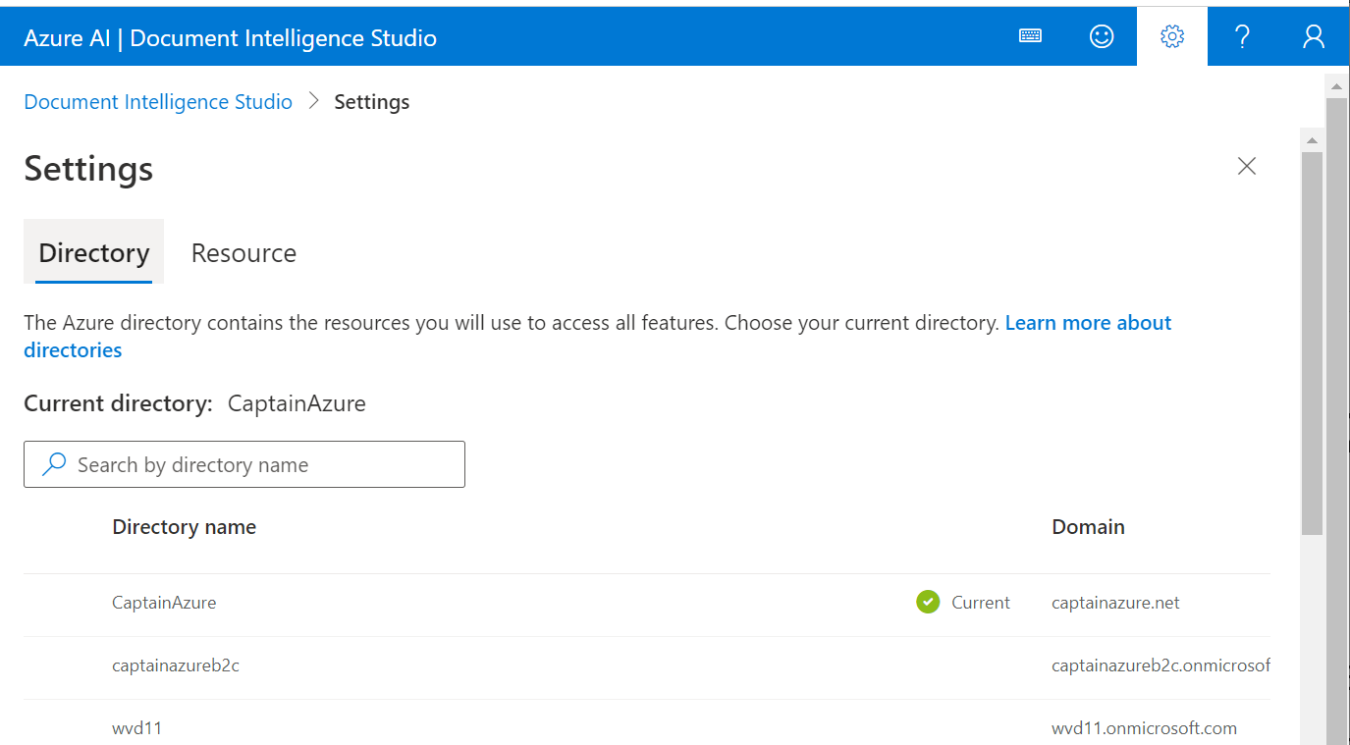
DI Studio –default enviroment

Slide 6
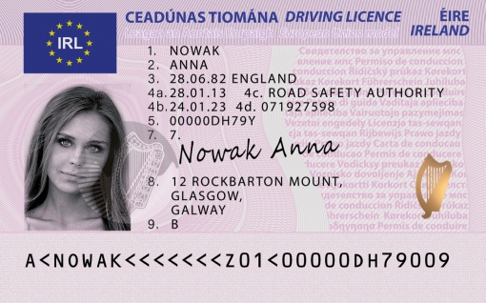
Irish Driving License
First Name: ANNA has confidence: 0.716
Last Name: NOWAK has confidence: 0.714
Document Number: 00000DH79Y has confidence: 0.858
Date of Birth: 1982-06-28 has confidence: 0.782
Date of Expiration: 2023-01-24 has confidence: 0.852
Address: AddressValue(
house_number=12,
po_box=None,
road=ROCKBARTON,
city=MOUNT, GLASGOW,
state=None,
postal_code=None,
country_region=None,
street_address=12 ROCKBARTON,
unit=None,
city_district=None,
state_district=GALWAY,
suburb=None,
house=None,
level=None) has confidence: 0.716

Slide 7
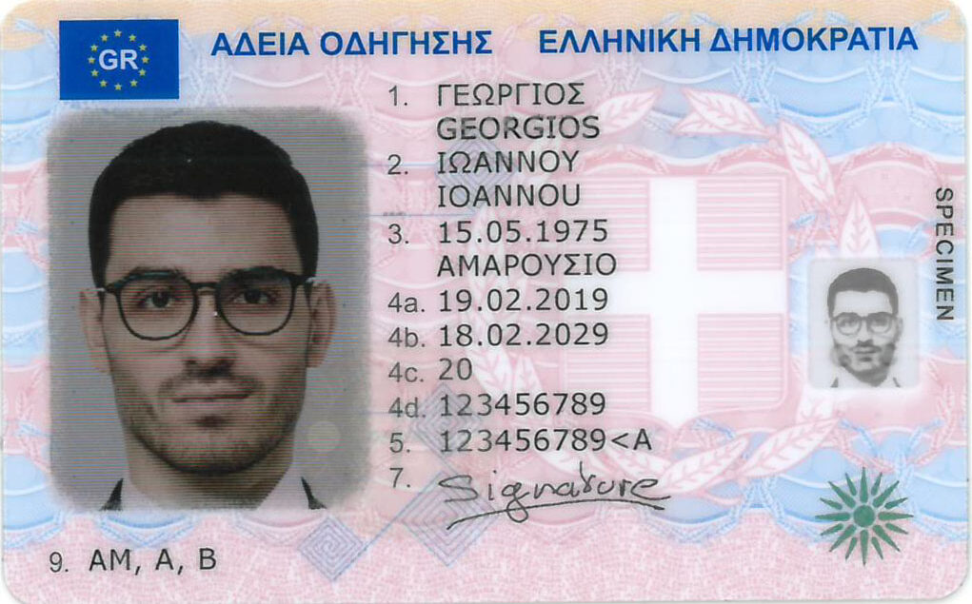
Greek Driving License
Will need to specify the correct locale:
fr_locale="el"
First Name: ΙΩΑΝΝΟΥ IOANNOU confidence: 0.649
Last Name: ΓΕΩΡΓΙΟΣ GEORGIOS confidence: 0.622
Document Number: 123456789<A confidence: 0.859
Date of Birth: 1975-05-15 has confidence: 0.858
Date of Expiration: 2029-02-18 has confidence: 0.86

Slide 8
Custom Document Format
Step by step guide

Slide 9
Number Plate Recognition

Slide 10
Prereq
Azure
Create “Computer Vision” service
Create Azure Machine Learning service
Dev Machine
The demo is using Anaconda notebooks
Alternatively
VS Code locally – requires Anaconda environment
VS Code on the web – requires Jupiter Server to run notebooks
Azure Machine Learning

Slide 11
https://github.com/nfmoore/automatic-number-plate-recognition-poc

Slide 12
Example on GitHub
Notes:
https://github.com/nfmoore/automatic-number-plate-recognition-poc

